Slide 1
Onboard, Online:
Cost-Effective Origin-Destination Research
Using Online Sample
Alex Levin
TRB AppCon 2019
June 3, 2019

Slide 2
Background

Slide 3
Transit Origin-Destination (OD) surveys
ODs are an important planning resource for transit agencies.
WHAT IS IT?
Survey of onboard riders
  Trip characteristics
  Demographics
The who, what, when, where, why for public transit
WHY DO IT?
General strategic planning
Title VI analysis and reporting
FTA New Starts requirement -- before/after
Notes:
Trip characteristics:
origin, destination, routes used, access/egress mode, time of day, trip purpose, etc.
Demographics:
race, income, age, gender, etc.

Slide 4

Challenge
Best practice says an Origin-Destination should include a 10% sample of daily ridership. This level of effort can become cost-prohibitive.
FOR EXAMPLE, FOR …
1.6 million daily rides * 0.10 = 160k rider sample size = $$$
NEED TO BE REALISTIC
Onboard surveys are expensive
Agencies don’t have unlimited budgets for research
Large onboard efforts become financially infeasible, even if valuable
Notes:
-MNR: 2006, 90k completes, $2+million

Slide 5
Application

Slide 6


Trade-offs
When “pure” onboard intercept becomes too expensive, online recruitment can significantly reduce costs and help ensure a sufficiently large sample.
OPTION A: ONBOARD ONLY
Onboard surveyor labor is expensive; no economies of scale
Fewer completions
Established methodology
OPTION B: ONLINE/ONBOARD
Online surveying is relatively inexpensive at scale
More completions
New methodology
Notes:
-ODs a last frontier for no online…because it feels so “place-based”: sampling plan, tell me about your current trip, etc.
Removed some sub-bulllets to make cleaner:
Fewer completions
Less statistical power
Less granular analysis
Established methodology
Trusted as best practice
Clear roadmap for project
More completions- INCLUDING SHORT TRIPS
More statistical power
More granular analysis
Unproven methodology
Not trusted as best practice
No clear roadmap for project

Slide 7
Getting onboard… with going online
A sound methodology and outlook are needed to ensure online sample effectively complements onboard sample. RSG took key measures/strategies at each step to ensure this.
MIND THE GAP
Embrace complementarity
  Aim for comparability, but acknowledge difference
METHODOLOGY MATTERS
Key measures taken in three notable areas
  Recruitment
  Survey format
  Weighting/Expansion

Slide 8


METHODOLOGY
Recruitment – Email List
A good email list is a must.
KEY LIST CHARACTERISTICS
  Size: represents a large percentage of riders
    88% of CTA boardings in 2017 used Ventra
  Scope: represents a large cross-section of rider types

Slide 9
METHODOLOGY
Recruitment – Gap Coverage
It’s critical to account for “holes” in the email list.
TARGETED INTERCEPT
  Used CTA payment data to assess high cash-use geographies
  Oversampled onboard in those areas to complement the online effort
Bus Route | Cash Use | Onboard Sampling Target
 | (% of total entries) | (% of total target)
134-Stockton/LaSalle Express (North Lake Shore Drive Express) | 2% | 0%
J14- Jeffery Jump (South Lake Shore Drive Express) | 7% | 34%
High cash use
Oversample

Slide 10
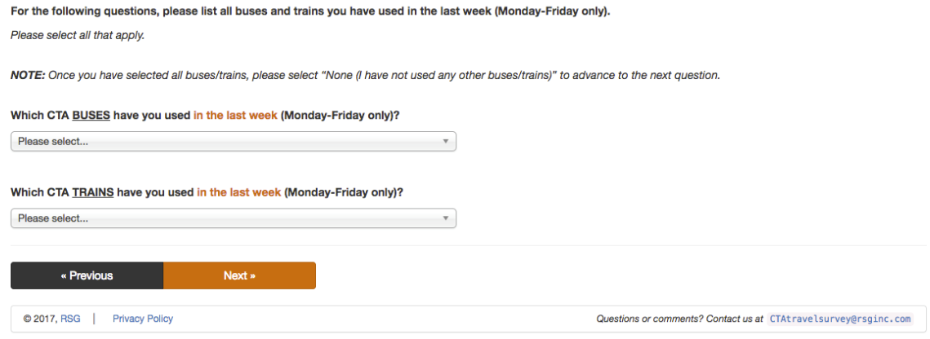
METHODOLOGY
Survey Format – Trip Diversity
A wide spread of trips need to be captured.
QUOTAS
  Ask respondents which routes/lines they have used recently
  Based on their selections, assign to route/line based on “need”

Slide 11
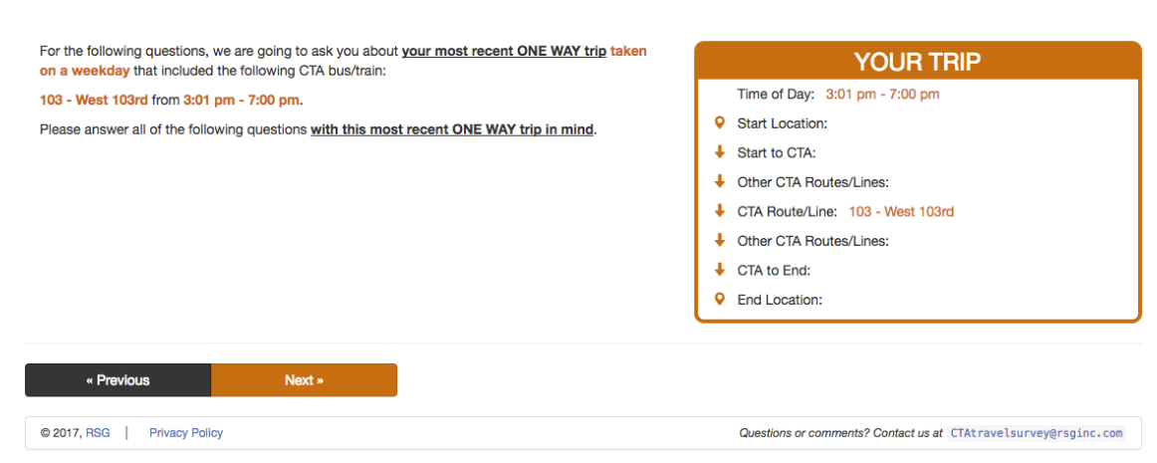
METHODOLOGY
Survey Format – Trip Accuracy
The survey should be structured so respondents can accurately describe their trips, as if in real-time, onboard.
TRIP-BUILDER
  Build out language and interface based on “assigned” trip
  Walk respondent through their trip, as if an onboard conversation

Slide 12
METHODOLOGY
Weighting/Expansion
Available onboard data can be used to make reasonable adjustments for comparability.
CLOSING THE GAP, ONE LAST TIME
  We know that an email list includes lots of infrequent riders (e.g., occasional business travelers, the “let’s go to the city” trips)
  Weight online trip frequency distribution (skewed infrequent) to that of onboard sample (less skewed) before expanding
Unweighted 2017 CTA Trip Frequency by Intercept Mode
Trip Frequency | Online | Onboard | Overall
5 days per week or more | 52% | 69% | 54%
1-4 days per week | 24% | 24% | 24%
Less than 1 day per week | 23% | 6% | 22%
Total | 100% | 100% | 100%

Slide 13
RESULTS
Online and Onboard Samples
Online data can show biases (as all sample data do!), but onboard and online data can and should complement each other in geographies where bias is greatest.
COMPLEMENTARY SUB-SAMPLES
  We know online sample will miss cash riders; onboard sample captures this
  By focusing onboard sampling in those areas w/ high cash ridership, we close other data distribution gaps that would exist in those geographies

Slide 14
RESULTS
Demographics
The data show difference and complementarity between onboard/online sample. However, the online differences are more pronounced for demographics than for trip characteristics.
Annual Household Income
(CTA by Intercept Mode and Year)

Slide 15
RESULTS
Trip Characteristics
The data show difference and complementarity between onboard/online sample. However, the online differences are more pronounced for demographics than for trip characteristics.
Trip Purpose
(CTA by Intercept Mode and Year)

Slide 16
Why It Matters

Slide 17
Innovative Survey Data
“[inspirational quote about adaptation]”
–Darwin/Charlie Kaufman/Gabe Klein
OVERCOME SHRINKING BUDGETS; MIND THE GAP
  Online sample a viable complement to onboard OD surveying when $ is tight (<1/2 the cost of onboard!)
  Don’t be scared to go mixed-mode: embrace compromise to avoid trading one set of issues wholesale for another
2017 CTA OD Completion and Cost Summary
 | Completions |  |  | Cost
Year | Onboard | Online | Total | Per Survey
2007 | 34,102 | - | 34,000 | $24
2017 | 5,174 | 37,000 | 42,000 | $11
Notes:
Nearly 70,000 completes, but only 42,000 weighted and used in analysis

Slide 18
Alex Levin
SENIOR ANALYST
Contacts
alexander.levin@rsginc.com
312.605.9206
Florian Fessel
www.rsginc.com
SENIOR CONSULTANT
florian.fessel@rsginc.com
802.861.0507
Greg Spitz
Emily Drexler
SENIOR DIRECTOR
STRATEGIC PLANNER
greg.spitz@rsginc.com
802.359.6424
edrexler@transitchicago.com
312.681.4249

